Slide 1

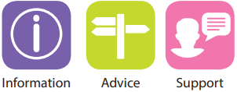
SENDIASS –
who we are
and what we do

Slide 2
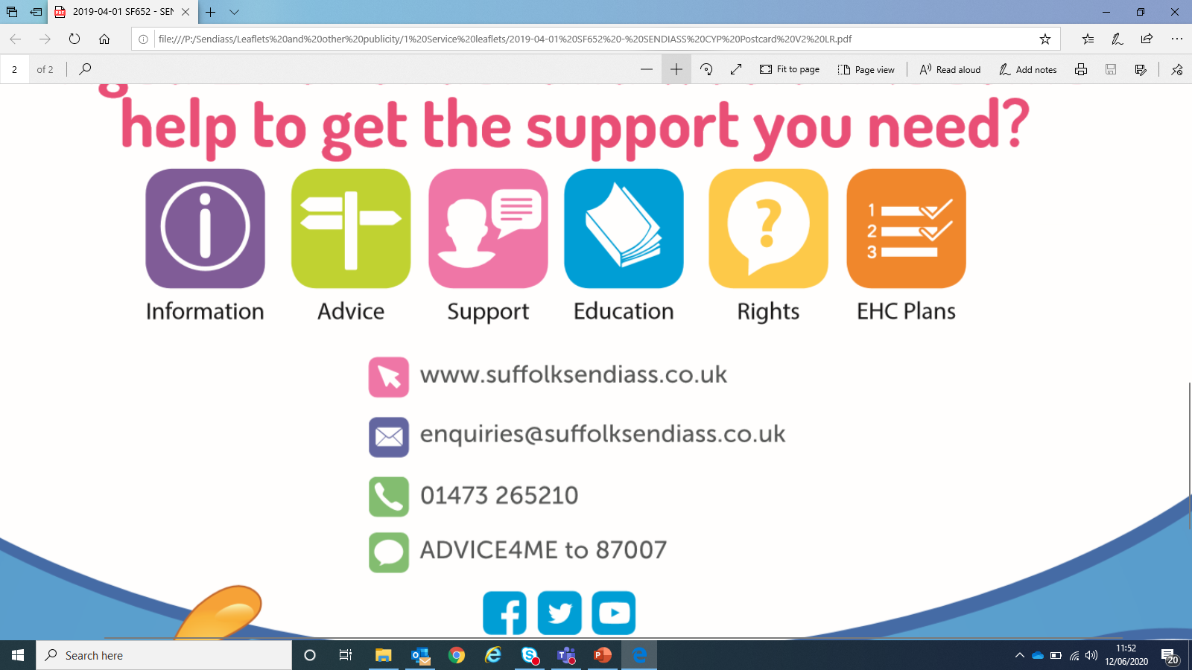

SENDIASS is a free, statutory,
impartial and confidential service
for children and young people
with special educational needs or
disabilities (SEND) and for their
parents/carers.
Notes:
As per the C& F Act and the SEND Code of Practice. Highlight that CYP do not need their parent’s permission to contact us – they have the right to impartial and confidential advice themselves. Also highlight that if the CYP is happy to share, then info can of course be shared with the family and we have often worked with both parents and pupils together in the past.

Slide 3
We aim to:
Give children, young people and families the information and the confidence they need to take a full part in decisions around learning and developing the pupil’s life skills.
Empower them so that they understand and feel clear about their options and can make their own choices going forwards.

Slide 4
Our impartiality means:
We work at ‘arms-length’ from the local authority
We offer information, advice and support which is based firmly in law and the SEND Code of Practice and we offer this in an unbiased way.
We are not influenced by a particular point of view or local policy and we do not judge.
We aim to help families have clear, accurate and relevant information that will help them take part in making decisions about their lives.
Notes:
Explain no vested interest beyond supporting families to participate and support them, learning settings and the LA to work together positively in the interests of the CYP.

Slide 5
Our remit
We can offer advice and support for children and young people aged 0 – 25 years, if they need extra help with their learning or have a disability.
There is no need for a child or young person to have a diagnosis or identified SEN to contact us. Many people seek our advice when their child’s needs are still unclear.
Our statutory remit includes providing training to practitioners around SEND. Our team has all undertaken accredited legal training.

Slide 6
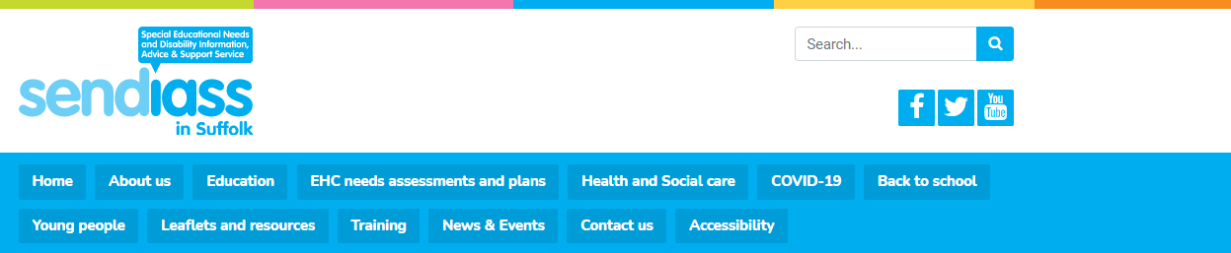
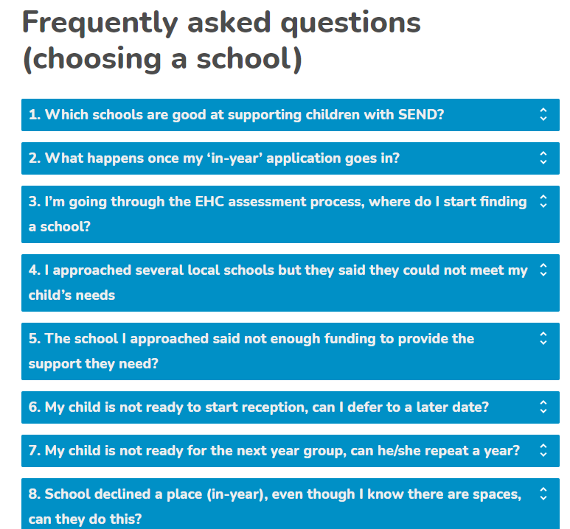
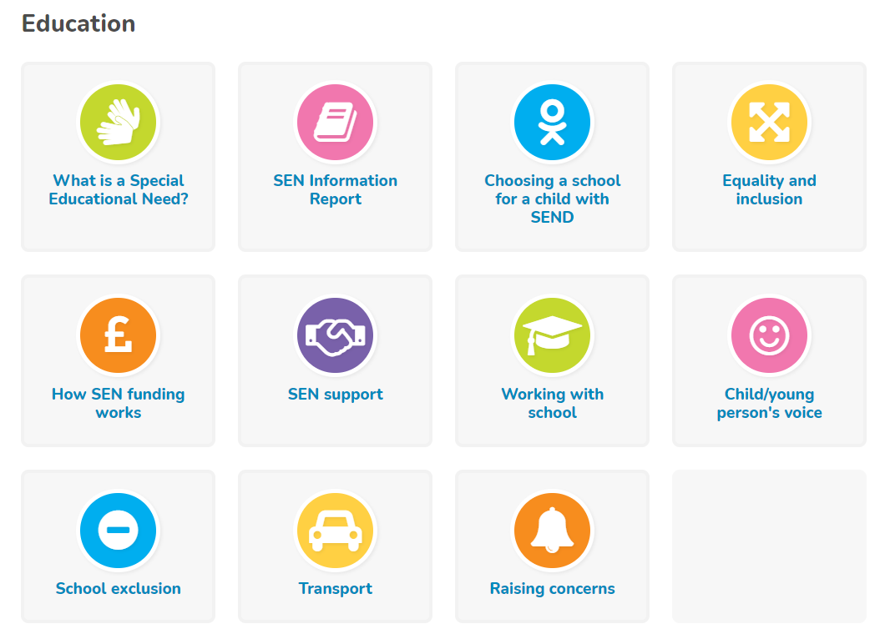
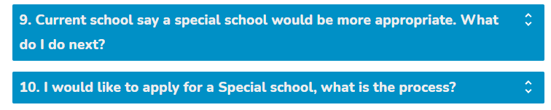
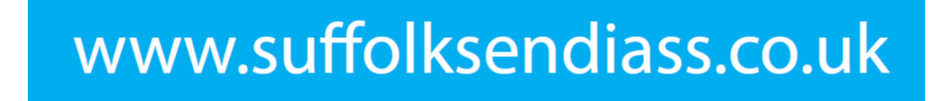
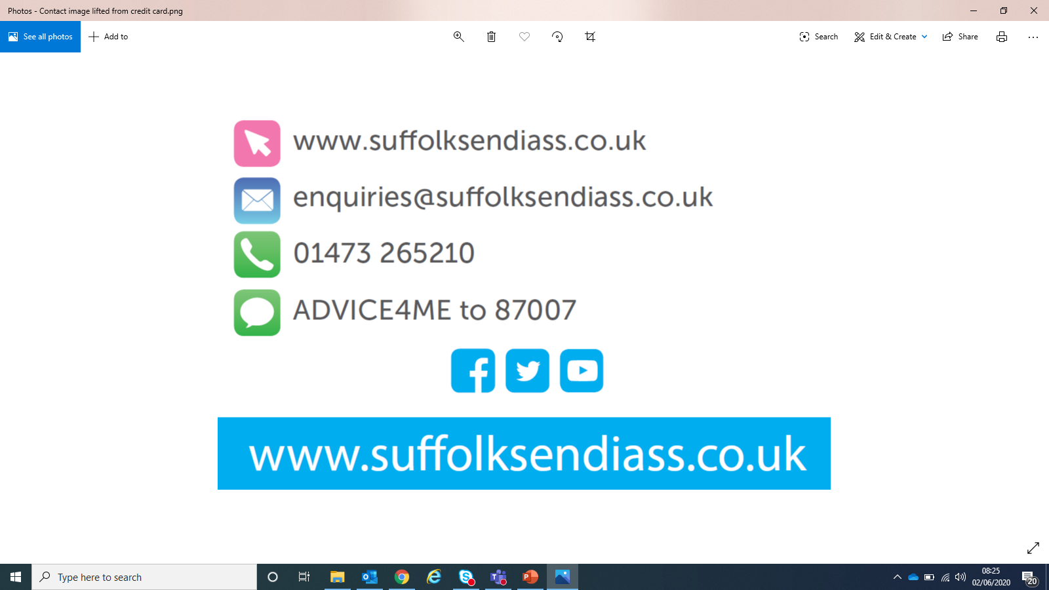
Support & information via our
impartial website, including FAQs
Notes:
FAQ webpages on our website can offer quick answers

Slide 7
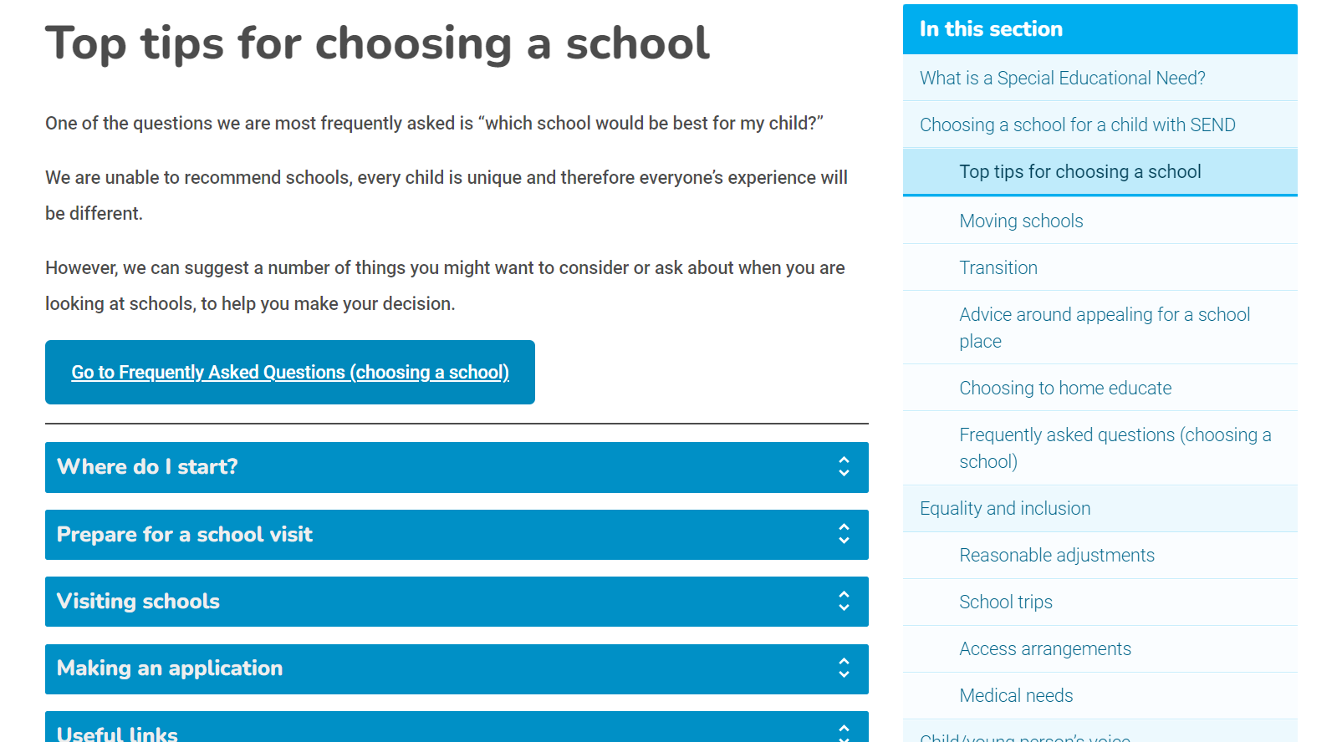
.. and ‘top tips’
Notes:
FAQ webpages on our website can offer quick answers

Slide 8
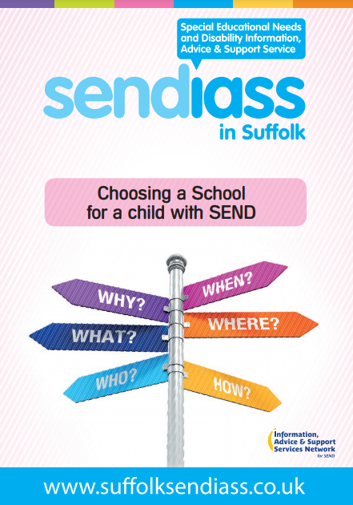
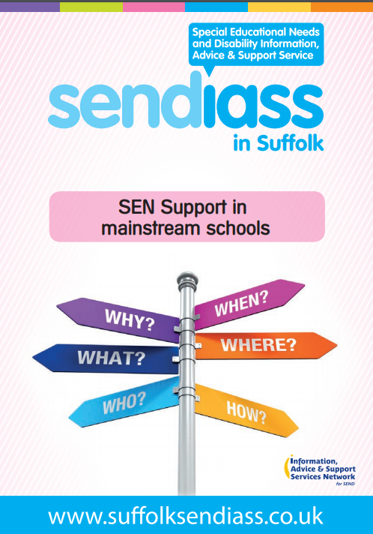
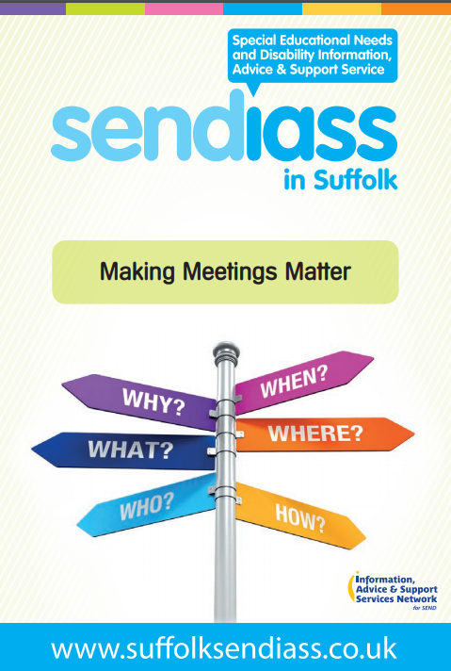
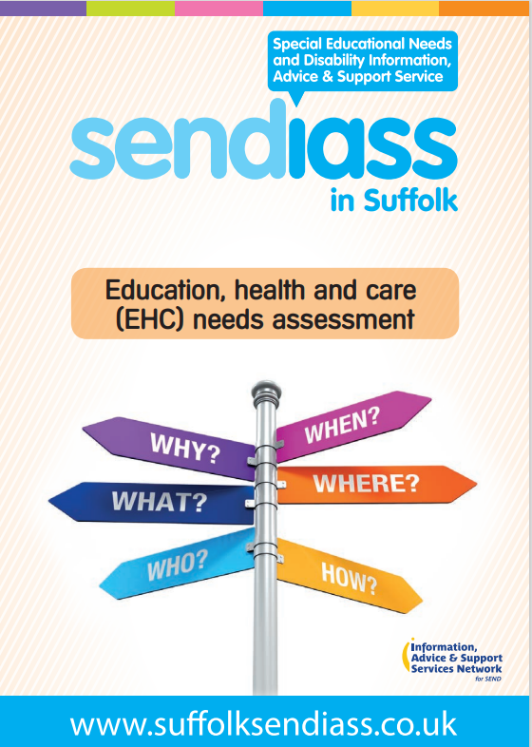
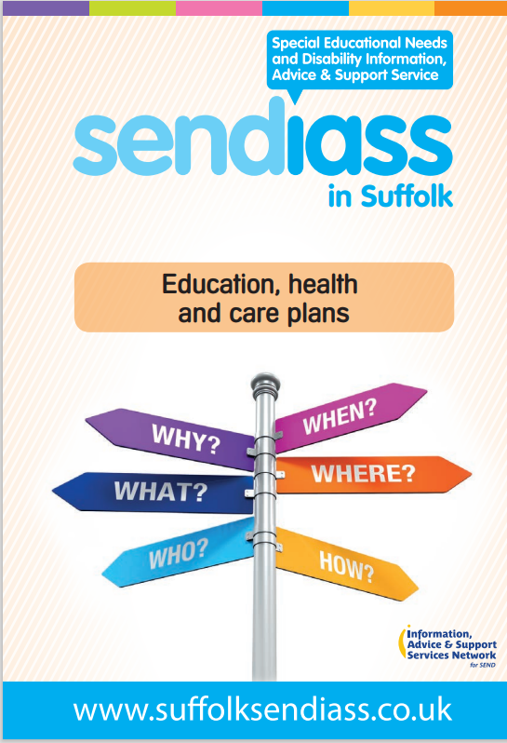
Via a range of leaflets
Notes:
Electronic forms of all our leaflets are downloadable from our Leaflets and Resources webpage. You can request hard copies too.

Slide 9
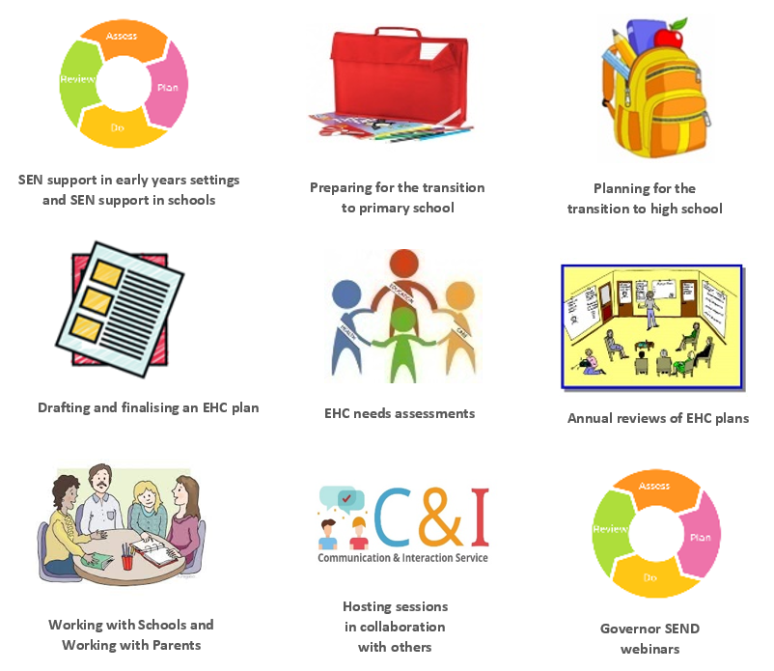
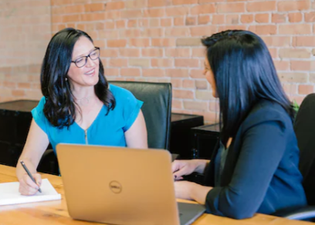
Support & information via workshops/webinars

Slide 10
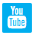
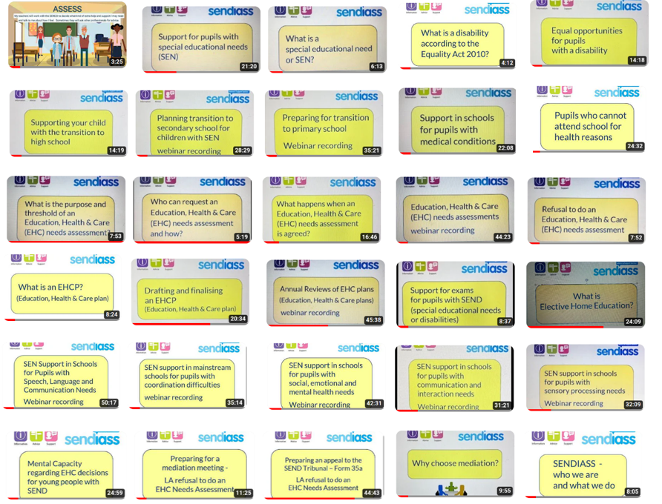
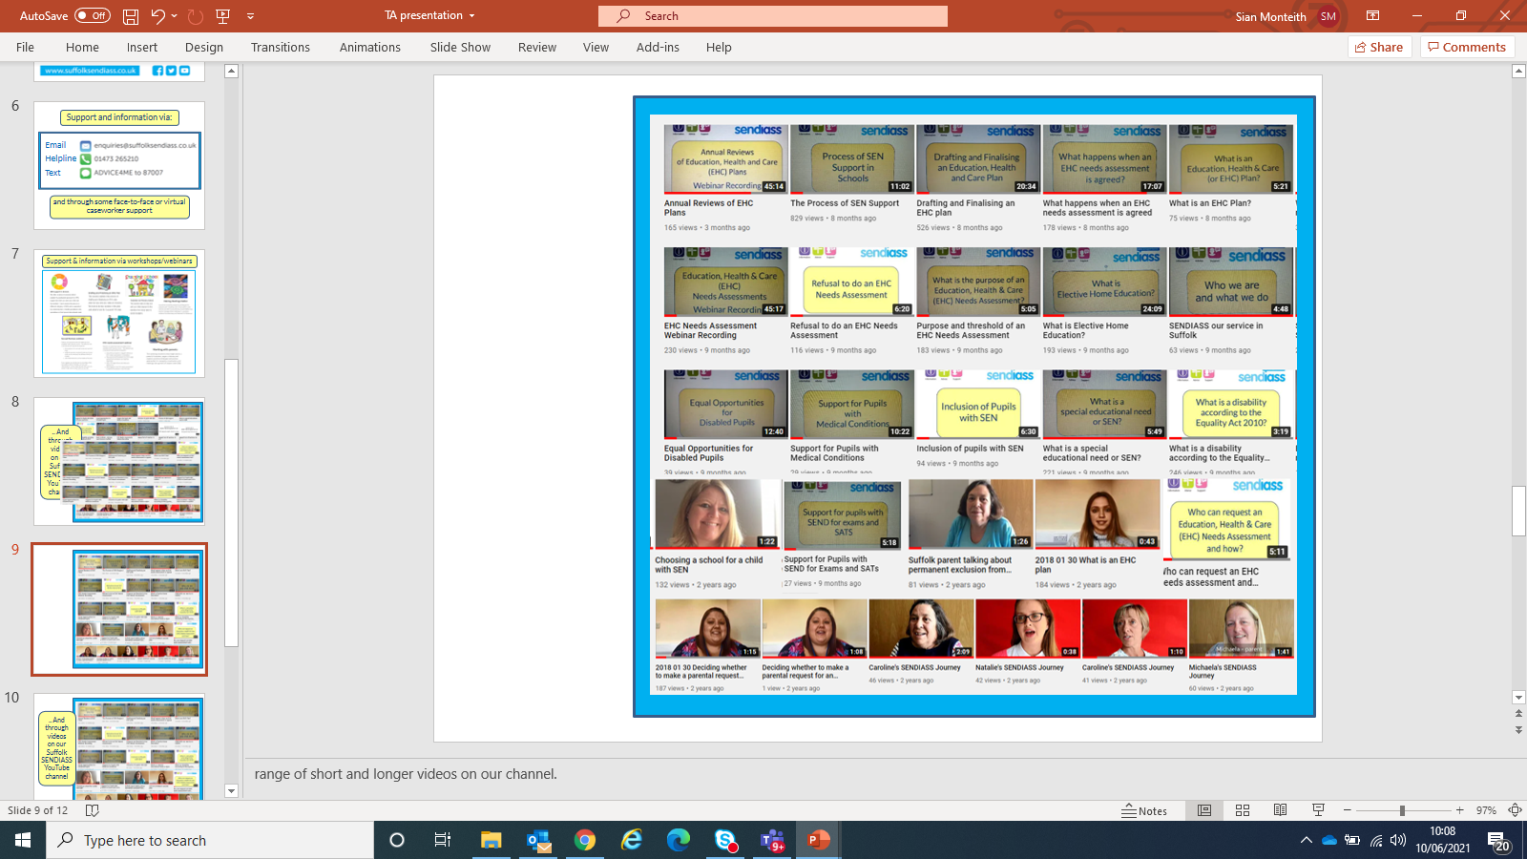
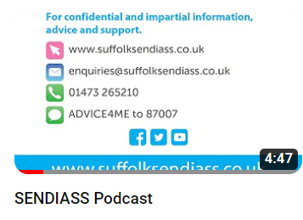
.. and through videos on our YouTube channel

Slide 11
Support and information via email, text or helpline
Contact form on our website
and through some face-to-face or
virtual caseworker support
Notes:
Explain helpline triage system and self-referral – option of text for vulnerable families and YPs. If there’s time and internet access, could show a couple of pages of our website.
Highlight how small our team is. Give examples of the kind of F/F support our caseworkers might be involved in (PEX cases, hearings, EHC appeals, YP home visit. Key meeting support etc)

Slide 12
The way we work:
We have no remit to direct families, learning settings or the local authority.
We explore options to empower children, young people and parents to make informed choices for themselves.
This may include helping families understand what the law expects to happen around education, health and social care matters and what is reasonable for learning settings to offer in terms of SEN support.

Slide 13
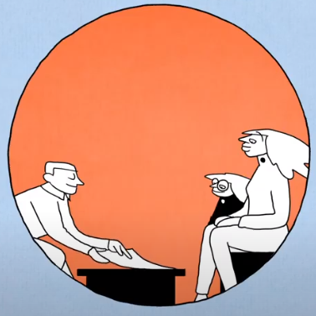
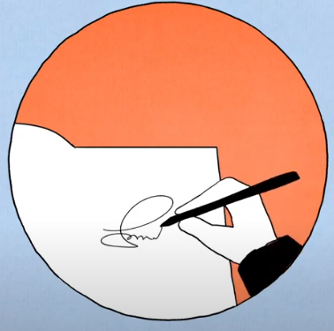
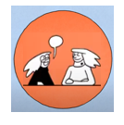
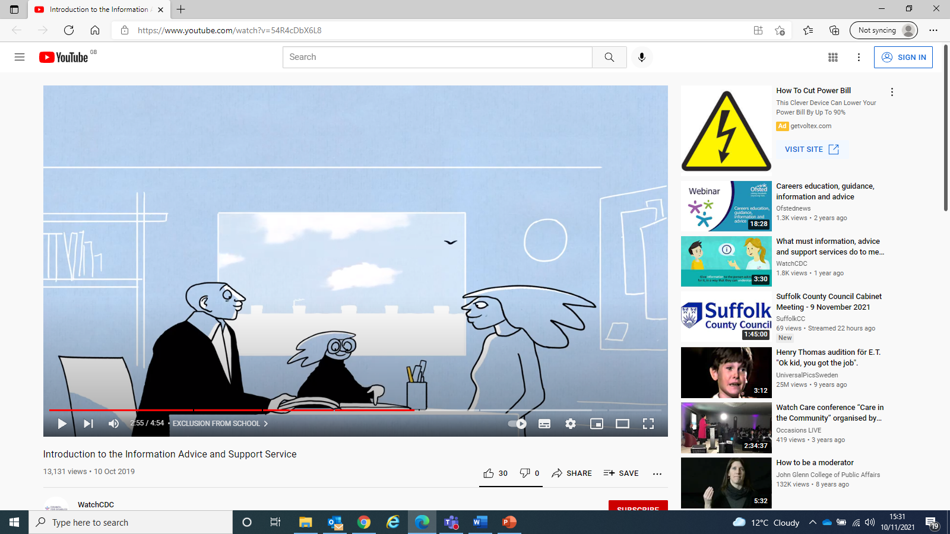
Depending on your individual circumstances, our support could include:
Support at and preparing for meetings
Help with understanding and completing paperwork
Help to take part in discussions and make decisions
Support to help you or your child clarify your views and find the confidence to express them

Slide 14
The way we work:
We aim to work in partnership with
families, learning settings, and the
local authority to help build positive
relationships & explore positive
solutions together.
.
Notes:
Could highlight that we aim to foster positive partnership working between families, learning settings and the LA. Much research has been undertaken in the past 20 years to evidence that CYP make the best progress when these are all working together and supporting each other to support the child.

Slide 15
SENDIASS Advisory Group
Our steering group is made up of key partners (parents, young people and practitioners) who meet each term to evaluate the quality and effectiveness of the information, advice and support we offer and to help us to develop our service, to better meet the needs of families.
.
We are keen for more parents and young people to join the group. Do contact us if you might be interested: enquiries@suffolksendiass.co.uk
.
Notes:
Could highlight that we aim to foster positive partnership working between families, learning settings and the LA. Much research has been undertaken in the past 20 years to evidence that CYP make the best progress when these are all working together and supporting each other to support the child.

Slide 16


