Slide 1


Ickworth Park Primary School
SATS information meeting
March 2026

Slide 2
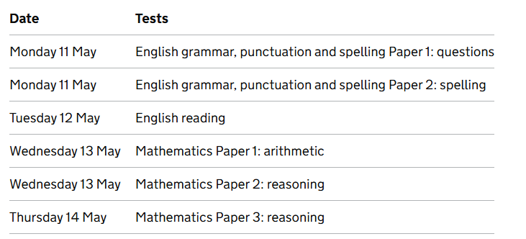
This will be the fifth time that Standard Assessment Tests (SATS) have been administered post pandemic. They are a test of pupils learning across Key Stage Two from years 3-6.
When are the SATS in 2026?
KS2 SATs consist of 6 papers that are sat within time restrictions. In addition, there is a teacher assessed element to establish a ‘writing’ score. These papers are sent back to be marked centrally with marks standardised around a score of 100, this means that 100 is the pass mark.

Slide 3
Assessment and Reporting
With the introduction of a new national curriculum in 2016, there also came changes to the SATs . The SATs exams for English and maths were adjusted to reflect the new curriculum. A completely new marking scheme and grading system were also introduced. The tests are more thorough than the previous style, in an attempt to better evaluate the children's progress.
From 2016, test scores have been reported as ‘scaled scores’ with a scaled score of 100 representing the expected national standard.
There is a set procedure that we have to follow when administering the tests, a script is provided for us to read out and we cannot deviate from this. Two adults have to be present in the room as the tests are administered and supportive classroom displays have to be covered or removed from the walls.

Slide 4
How the tests are marked
All test papers are marked by external moderators so accuracy is very important. Some are marked by computer and so children need to write clearly and neatly.
Writing is judged by teacher assessment. Moderators from Suffolk County Council will visit a selected number of schools over the second half of the summer term and each class teacher will be asked to provided evidence to justify their assessments.
Scaled Scores in tests for reading, spelling, punctuation, grammar and maths
100 represents the ‘national standard’ which children are judged against at the end of Key Stage 2 (Year 6)
Each pupil’s raw test score will be converted into a score on the scale, either at, above or below 100.
The scale will have a lower end point of 80 and an upper end point of 120.
Each pupil will receive:
A raw score (number of raw marks awarded).
A scaled score in each tested subject.
Confirmation of whether or not they attained the national standard. These will be sent out alongside school reports in the last week of term. The data is only available to schools to view online from 7th July onwards.

Slide 5
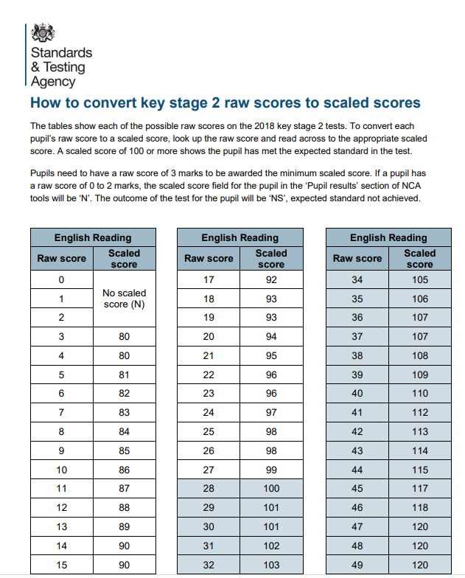
The ‘raw score’ is converted into a scaled score. This scaling alters each year to reflect the test papers.

Slide 6
SATS week:
Monday 11th May – Thursday 14th May
Test | Number of marks available in the paper | Total number of marks available for the test – highest raw score
English reading | 50 marks | 50 marks
English grammar, punctuation and spelling Paper 1: questions | 50 marks | 70 marks
English grammar, punctuation and spelling Paper 2: spelling | 20 marks
Mathematics Paper 1: arithmetic | 40 marks | 110 marks
Mathematics Paper 2: reasoning | 35 marks
Mathematics Paper 3: reasoning | 35 marks

Slide 7
Spelling, Punctuation and Grammar – Monday 11th May
A Spelling test is administered containing 20 words, lasting approximately 15 minutes. These words will be from the words children should know by the end of year 6.
A separate test is given on Punctuation, Vocabulary and Grammar (50 marks)
This test lasts for 45 minutes and requires short answer questions, including some multiple choice.
Marks for these two tests are added together to give a total for Spelling, Punctuation and Grammar.

Slide 8
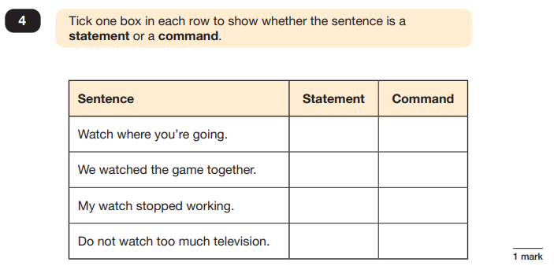

Slide 9
Reading – Tuesday 12th May
The Reading Test consists of a single test paper with three unrelated reading texts.
Children are given 60 minutes in total, which includes reading the texts and answering the questions.
A total of 50 marks are available.
Questions are designed to assess the comprehension and understanding of a child’s reading. The test is also designed to assess the fluency of a child’s reading through the amount of text that the child has to read in order to complete the reading test.
Some questions are multiple choice or selected response, others require short answers and some require an extended response or explanation.

Slide 10
Mathematics – Wednesday 13th May (paper 1 &2 )
Thursday 14th May (paper 3)
Children will sit three tests: Paper 1, Paper 2 and Paper 3.
Paper 1 is for ‘Arithmetic’ lasting for 30 minutes, covering calculation methods for all operations, including use of fractions, percentages and decimals.
Questions gradually increase in difficulty. Not all children will be expected to access some of the more difficult questions later in the paper.
Papers 2 and 3 cover ‘Problem Solving and Reasoning’, each lasting for 40 minutes.

Slide 11
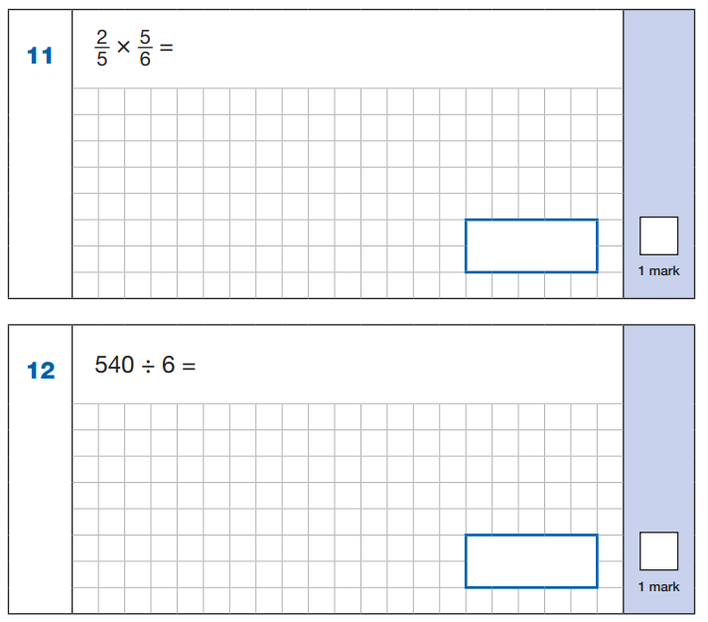
Arithmetic Paper

Slide 12
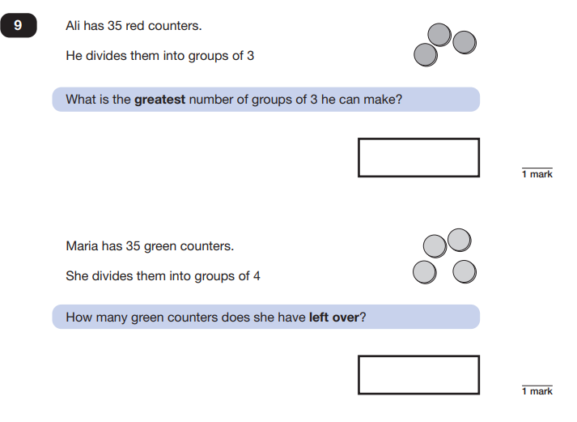
Reasoning Paper

Slide 13
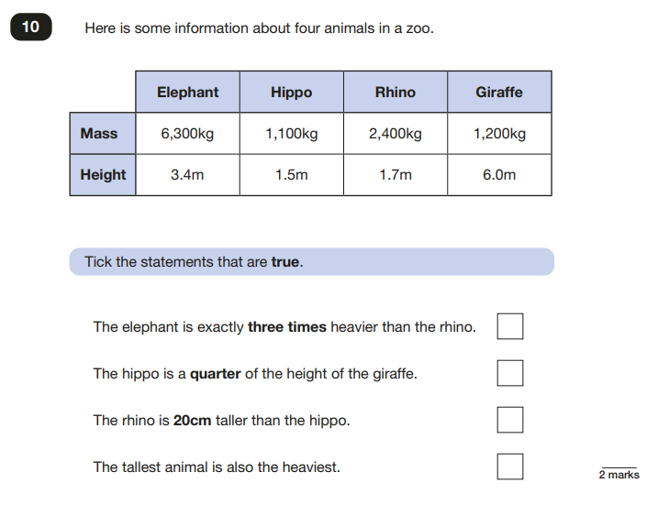

Slide 14
How can I help?
First and foremost, support and reassure your child that there is nothing to worry about and they should always just try their best. Praise and encourage!
If you feel your child is feeling pressured or worried please come and speak to me in school.
Provide support for homework tasks and ensure accuracy when they are answering questions. Please encourage your child to work through their CGP book during the Easter Break. The children are also able to complete MyMaths and Purple Mash games to help them with their revision.
We want all of our children to perform to their best but remember that this is a snapshot of how they performed in a particular test, on a particular day.
We will encourage the children to come into school at 8:15am during SATS week to join us for breakfast so that we can all get together at the start of the day, calm nerves and settle into a routine for the week.
The children will be encouraged to bring a small mascot into school during the week to sit on their table and support them during the tests.

Slide 15
While we understand children and parents can feel anxious about the SATs tests, it is important to remember that children generally really enjoy SATS week. They know what to expect, the classroom is a calm and quiet place each morning, with fun activities to look forward to in the afternoons.
Children love having breakfast together and chatting about what might be in each test.
Children have sat mock versions and know the type of questions and what it will feel like.
Where children meet the threshold for additional support, they can sit in a separate room with an adult and take breaks during the test. Some will also qualify for extra time, although this only works out to be a short time, it can help with settling nerves and anxiety.
The children have worked hard for the last seven years and want to be able to show off how much they have learned and how good they are.

Slide 16
The week in school……………
Maths revision will continue in school before the children sit the papers on Wednesday.
In the afternoons, the children will continue with lessons across the foundation subjects while they are sitting the tests in the morning. One of these sessions will be a longer outdoor PE session and one of the lessons will be based around use of the chrome books which they enjoy using.
After the children have completed the tests, we will have an extended playtime and weather dependent, may go over to Ickworth Park to play in the woods.
On Friday, the children will vote on a treat activity they wish to do in the afternoon as a huge congratulations for their hard work and positivity.
Any questions?

